Slide 1

Database Systems for S/W Applications
[55-500998]
Lecture 13
Kostas Domdouzis
Department of Computing
Sheffield Hallam University

Slide 2
The Information System
Database
Carefully designed and constructed repository of facts
Part of an information system
Information System
Provides data collection, storage, and retrieval
Facilitates data transformation
Components include:
People
Hardware
Software
-Database(s)
-Application Programs

Slide 3
Database Design Steps
Conceptual Database Design (Data Modelling)
The Entity Relationship Model(ER Model) is used at the conceptual design stage of the
database design. The Entity Relationship Diagram (ER Diagram) is used to represent this
conceptual design. The ER diagram consists of Entities, Attributes and Relationships.
Input for conceptual design step:
Requirements Analyzed in the previous step
Output of conceptual design step:
ER Diagram

Slide 4
ER Diagram
An entity-relationship diagram is a data modeling technique that creates a graphical representation of the entities, and the relationships between entities, within an information system.
Three Main Components
1. The entity is a person, object, place or event for which data is collected
2. The relationship is the interaction between the entities
3. The cardinality defines the relationship between the entities in terms of numbers

Slide 5
ER Modelling Approaches
Top-down
-starts from the general and moves to the specific. In other words, you start with a general
idea of what is needed for the system and then work your way down to the more specific
details of how the system will interact.
-This process involves the identification of different entities and the definition of each
entity’s attributes.

Slide 6
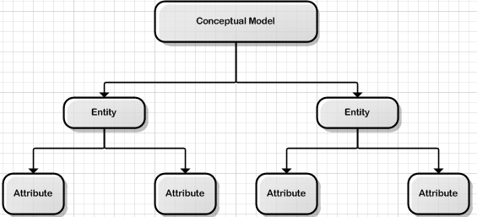
ER Modelling Approaches

Slide 7
ER Modelling Approaches
Bottom-up
-The bottom-up approach begins with the specific details and moves up to the general.
-This is done by first identifying the data elements (items) and then grouping them together in
data sets. In other words, this method first identifies the attributes, and then groups them to
form entities.

Slide 8
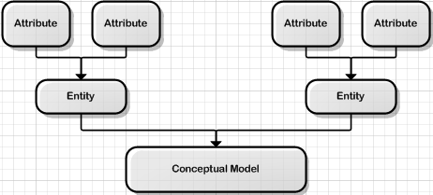
ER Modelling Approaches

Slide 9
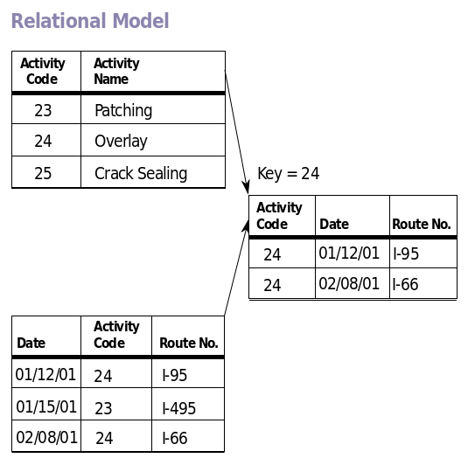
Top-down approach
Information about the problem
High-level description
Testimonies
Knowledge of the domain
Relational model

Slide 10
Entity
Entity: A ‘thing’ or an ‘object’ that is distinguishable from all the other objects.
An entity is something that occurs many times.
An entity is an object about which we want to store data.
Entities have attributes.

Slide 11
Check an entity is correct
4 Rules of thumb:
There should be several occurrences
e.g. there are lots of cars, of students, of books… to keep data about.
It has more than one attribute (not always)
It can exist only with one attribute (its key).
There is a unique identifier
The student number, car number plate, invoice number…
The entity is related to other ones in your model

Slide 12
What does a good ERD look like?
The least you need to know is:
Entity names
Attribute names
Primary keys
Foreign keys
As in this schema:
Relationships
Cardinalities
Labels
Teacher
Number
Name
ModuleTeacher
Teacher number*
Module number*
Time_period
Module
Module number
Subject
teaches
taught by
NB: the time period attribute is used to store when a teacher takes a given module.

Slide 13
Course notation (Crow’s Foot)
Entity – in a box, name at the top
Avoid names with spaces: CamelCase or under_score
Attribute names
Primary keys – underline
Foreign keys – star *; group composite FKs with a | vertical line
and star
Relationship cardinalities – Crow’s foot;
Relationship labels – left to right; if not mark the direction

Slide 14

Course notation
Jobs
jobID
deptID
empID
fromDate
description
Entity – in a box, name at the top
Avoid names with spaces: CamelCase or under_score
Attribute names – better if type is self evident; annotate if not
Primary keys – underline
Foreign keys – star *; group composite FKs with a | vertical line and star
Relationship cardinalities and optionality – crow’s foot; more on optionality later
Relationship labels – left to right; if not mark the direction
*
Note: an employee can work for several periods of time in a department.
is responsible for
EmpDept
Employee
Department
*
empID
firstName
lastName
hireDate
deptID
empID
fromDate
toDate
deptID
deptName
building
*
employs
<= works in

Slide 15
Strong vs. Weak Entities
An entity that has a primary key is called as Strong entity.
The entity which does not have sufficient attributes to form a primary key is called as Weak entity.
A weak entity does not have a primary key but we need a means of distinguishing among all those attributes in the entity that depend on one particular strong entity.
The discriminator of a weak entity is a set of attributes that allows this distinction to be made.
This discriminator is called the Partial key of the weak entity.

Slide 16
Example of Strong & Weak Entities
A very good example of this is the entity set of dependents of an employee of a bank.
The bank may want to store the dependents’ information for various reasons such as policies etc.
In this case the dependents are not uniquely identified by their attributes (name, age, gender (most likely)); But together with the employee-id of the employee they can be distinguished

Slide 17
Attributes
An attribute is a property or characteristic of an entity.
An attribute is exactly associated with one entity.
The database schema associates one or more attributes with each entity.
Attributes describe the instances in the row of a database.
Think of a table in a relational database as being analogous to a spreadsheet. An attribute is simply one cell in the spreadsheet, or the conjunction of a column and row. It stores only one piece of data about the object represented by the table in which the attribute belongs.

Slide 18
Types of Attributes
Single (atomic): Attributes that cannot be broken down further
Composite: Attributes that can be broken down further (eg. Address can be broken down further to street, town, postcode)
Multi-Valued: An attribute that has many values (eg. telephone number with local dialling code)
Complex: Attributes that are both composite and multi-valued
Stored & Derived: Derived attributes are attributes that derive their value from the stored attribute (eg. Age from the Date of Birth). A stored attribute supplies the value to the derived attribute.
Key: It is also called 'Key Identifier'. It is a single attribute or a combination of attributes that uniquely identify an individual instance of an entity.

Slide 19
Relationships
A relationship is an association between entities
Degree of a Relationship
Relationship Constraints
-Cardinality
-Participation (Optionality)

Slide 20
Degree of a Relationship
Unary (Recursive): Connects one entity with itself or it can be defined as an association between two different instances of the same entity.
• Binary: It is an association between two instances between two
different entities.
• Ternary: It is an association between three instances of three different
entity entities (eg. a student uses equipment for a specific project).

Slide 21
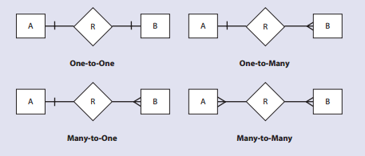
Cardinality
The ability to count the number of entities involved in a relationship. It represents the minimum/maximum number of instances of entity B that must/can be associated with any instance of entity A.

Slide 22
Relationships & Database Tables
One-to-One relationships occur when each entry in the first table has one, and only one, counterpart in the second table.
One-to-Many relationships occur when each record in the first table corresponds to one or more records in the second table but each record in the second table corresponds to only one record in the first table.
Many-to-Many relationships occur when each record in the first table corresponds to one or more records in the second table and each record in the second table corresponds to one or more records in the first table.

Slide 23
Participation Constraints
Optional relationship
e.g., an Employee may or may not be assigned to a Department
Participation of entity (e.g., Employee) in relationship
is said to be partial
Mandatory relationship
e.g., every Course must be Taught by at least one Lecturer
Participation of entity (e.g., Course) in relationship
said to be total

Slide 24
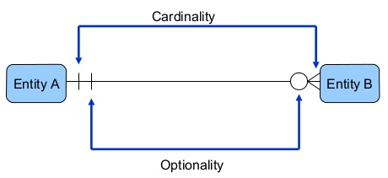
Participation Constraints
The optionality is shown inside the cardinality.

Slide 25




Participation Constraints
•One or many Entities B
•Zero or many Entities B
•One and only One Entity A
•Zero or One Entity A

Slide 26
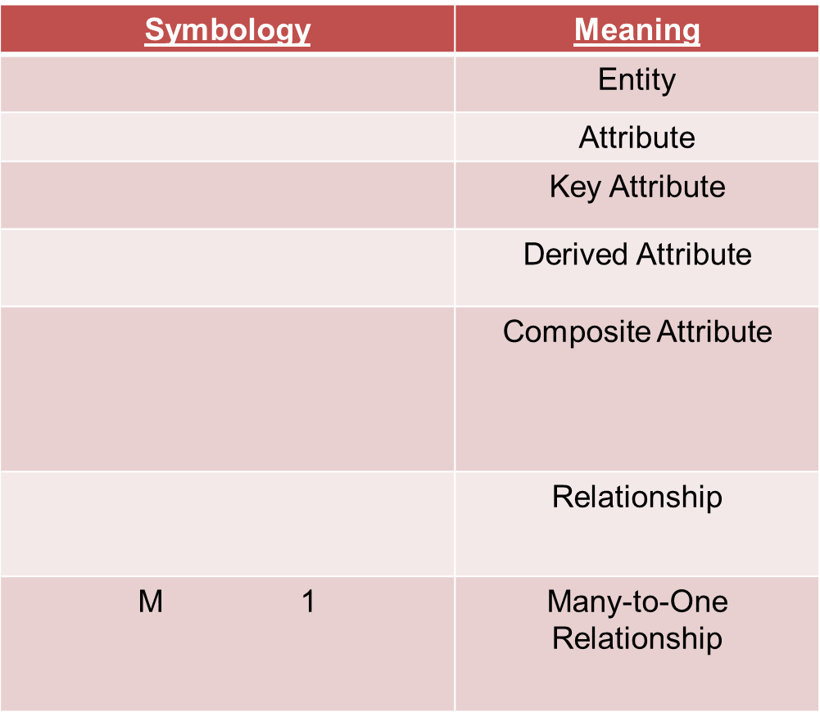


ER Diagrams Symbology (Chen’s Notation)

Slide 27
Functional Dependency
•Full Functional Dependency:
Given a Relation R(A,B,C,D), Where A,B,C,D are attributes.
-Functional Dependencies A→BCD , BC→D
A→BCD means A functionally determines BCD
BC→D means BC functionally determines D

Slide 28
Functional Dependency
•Partially Functional Dependency:
Indicates that if A and B are attributes of a table , B is partially dependent on A if there is some attribute that can be removed from A and yet the dependency still holds.
Given a relation R(A,B,C,D,E) , Functional Dependency : AB→CDE , Primary_key(or simply 'key') is AB.
Then A→C : is a Partial Dependency
A→D : is a Partial Dependency
A→E : is a Partial Dependency
B→C : is a Partial Dependency
B→D : is a Partial Dependency
B→E : is a Partial Dependency

Slide 29
Functional Dependency
•Transitive Functional Dependency:
A condition where A , B and C are attributes of a table such that if A is functionally dependent on B and B is functionally dependent on C then C is Transitively dependent on A via B.
Given a relation R(A,B,C,D,E) then dependency like A-->B, B-->C is a transitive dependency, since A-->C is implied.
Example:
EMPLOYEE_ID --> JOB_CATEGORY
JOB_CATEGORY --> HOURLY_RATE
An employee data table that includes the “hourly pay rate” would require searching every employee record to properly update an hourly rate for a particular job category.

Slide 30
End of Lecture

